Slide 1
Exceptions in Java

Slide 2
Exception
Exception is an abnormal condition.
Exception Handling is a mechanism to handle runtime errors such as ClassNotFoundException, IOException, SQLException, RemoteException, etc.
Error: An Error indicates a serious problem that a reasonable application should not try to catch.
Exception: Exception indicates conditions that a reasonable application might try to catch.

Slide 3
Major reasons why an exception Occurs
Invalid user input
Device failure
Loss of network connection
Physical limitations (out of disk memory)
Code errors
Opening an unavailable file

Slide 4
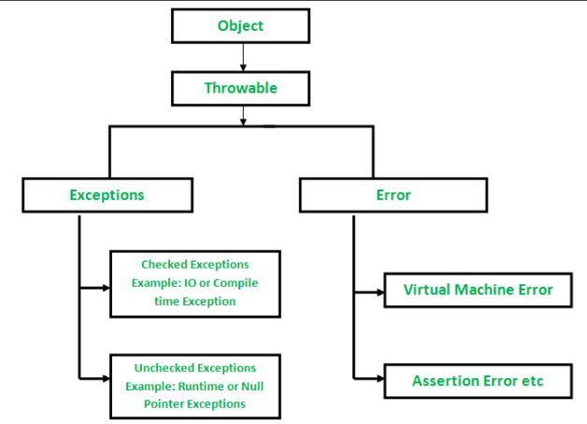

Slide 5
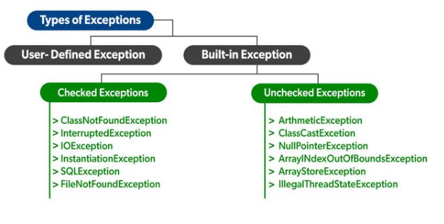

Slide 6
Exceptions can be Categorized in two ways:
1- Built-in Exceptions: are the exceptions that are available in Java libraries. These exceptions are suitable to explain certain error situations.
Checked Exception
Unchecked Exception
Checked Exceptions: Checked exceptions are called compile-time exceptions because these exceptions are checked at compile-time by the compiler.
Unchecked Exceptions: The unchecked exceptions are just opposite to the checked exceptions. The compiler will not check these exceptions at compile time. In simple words, if a program throws an unchecked exception, and even if we didn’t handle or declare it, the program would not give a compilation error.

Slide 7
2- User-Defined Exceptions:
Sometimes, the built-in exceptions in Java are not able to describe a certain situation. In such cases, users can also create exceptions which are called ‘user-defined Exceptions’.

Slide 8
Advantages of Exception Handling
Provision to Complete Program Execution
Easy Identification of Program Code and Error-Handling Code
Propagation of Errors
Meaningful Error Reporting
Identifying Error Types

Slide 9
Syntax
try {
// block of code to monitor for errors
// the code you think can raise an exception
}
catch (ExceptionType1 exO1) {
// exception handler for ExceptionType1
}
catch (ExceptionType2 exO2) {
// exception handler for ExceptionType2
}
// optional
finally {
// block of code to be executed after try block ends
}

Slide 10
Example of Exception
class GFG {
// Main driver method
public static void main(String args[])
{
// Taking an empty string
String str = null;
// Getting length of a string
System.out.println(str.length());
}
}

Slide 11
class GFG {
static int divideByZero(int a, int b)
{ int i = a / b; return i; } }
static int computeDivision(int a, int b)
{ int res = 0;
try { res = divideByZero(a, b); }
catch (NumberFormatException ex) { System.out.println("NumberFormatException is occurred");}
return res;
}
public static void main(String args[])
{
int a = 1;
int b = 0;
try {
int i = computeDivision(a, b);
}
catch (ArithmeticException ex) {
System.out.println(ex.getMessage());
}}}

Slide 12
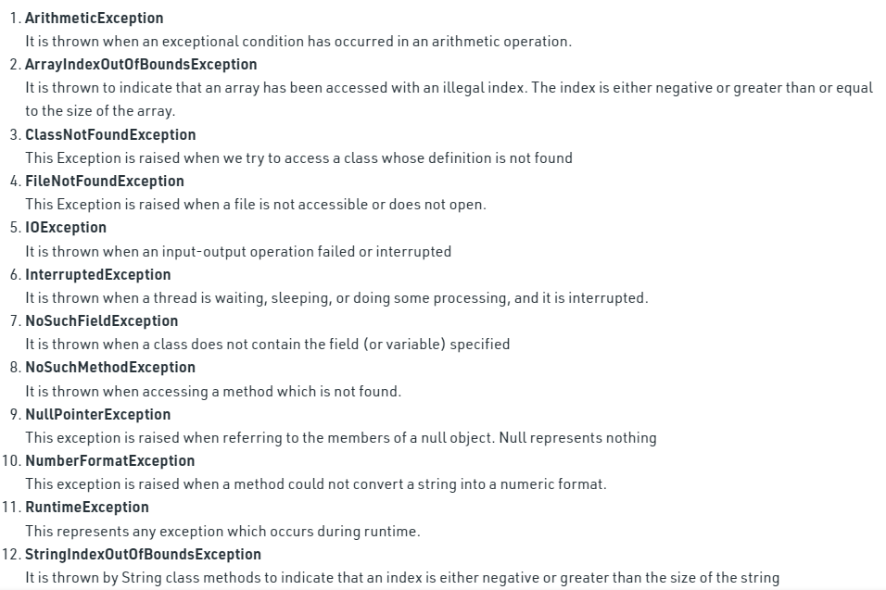

Slide 13
class MyException extends Exception
{
private static int accno[] = {1001, 1002, 1003, 1004};
private static String name[] = {"Nish", "Shubh", "Sush", "Abhi", "Akash"};
private static double bal[] = {10000.00, 12000.00, 5600.0, 999.00, 1100.55};
MyException() { }
MyException(String str) { super(str); }
MyMsg(String str) { System.out.println (“Error Occurred ! ”); }
public static void main(String[] args)
{
try {
System.out.println("ACCNO" + "\t" + "CUSTOMER" + "\t" + "BALANCE");
for (int i = 0; i < 5 ; i++)
{ System.out.println(accno[i] + "\t" + name[i] + "\t" + bal[i]);
if (bal[i] < 1000) {
MyException me = new MyException("Balance is less than 1000");
throw me;
}
}
}
catch (MyException e) {
e.printStackTrace();
} }}

